Slide 1

WP4: 1st International Workshop
City of Abano Terme experience in sustainable planning
Sandra Zanellato
Municipality of Abano Terme
3rd Sector "Government of the Territory“
Vienna - April 26, 2023

Slide 2
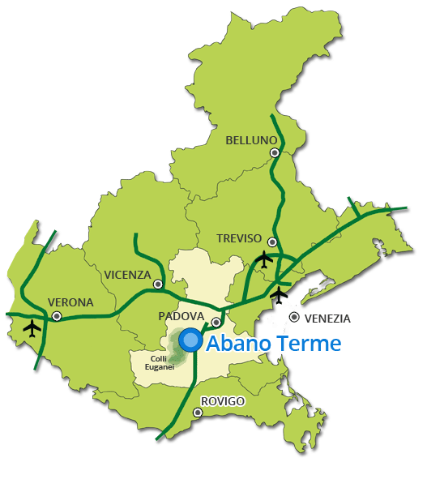
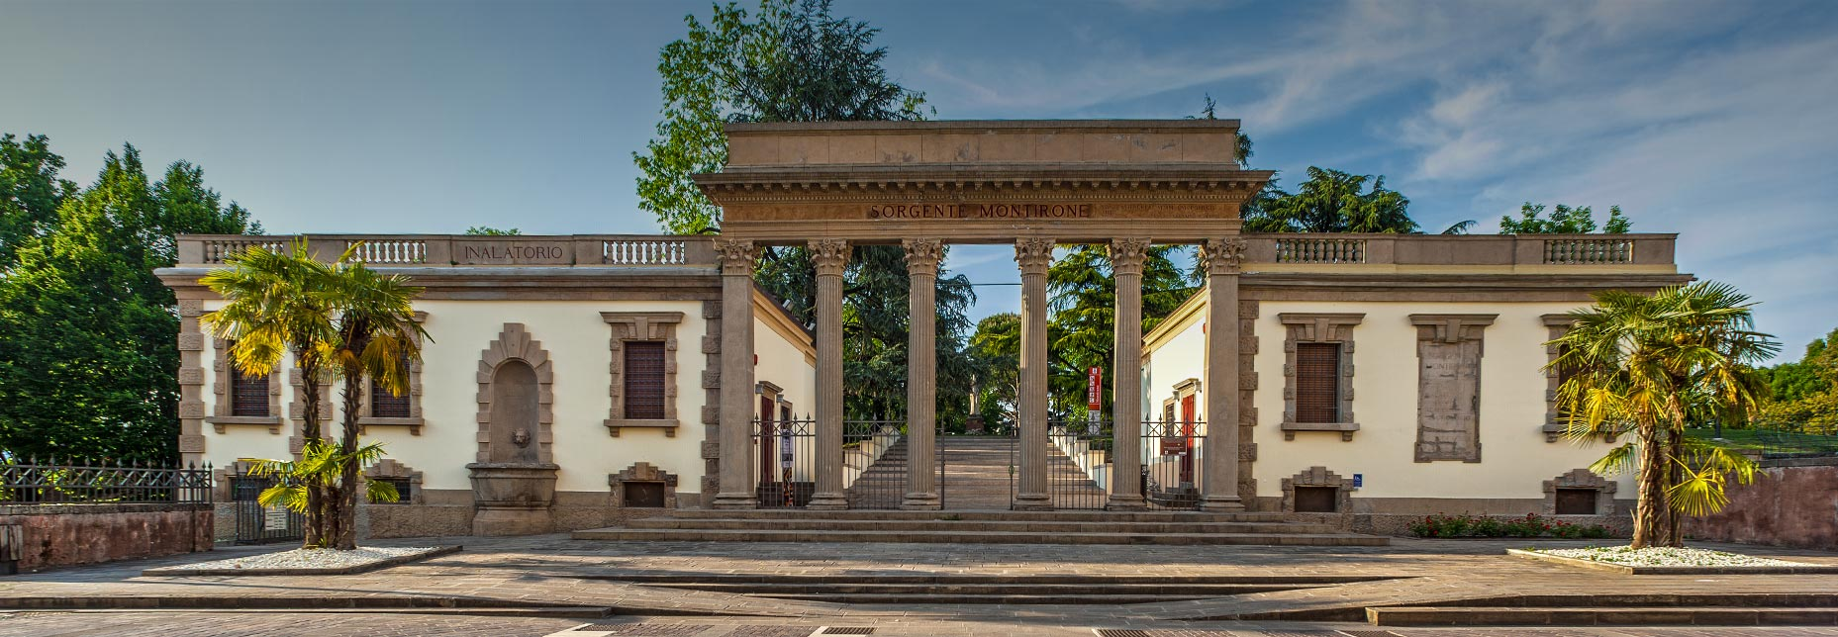

City of Abano Terme
Abano Terme is the most important thermal center in Europe, it stands in a position at the foot of the Euganean Hills, a group of hills made up of around a hundred hills of different shapes and heights which occupy an area of 180 km². The city has more than 20,000 inhabitants and covers 21.41 km².

Slide 3
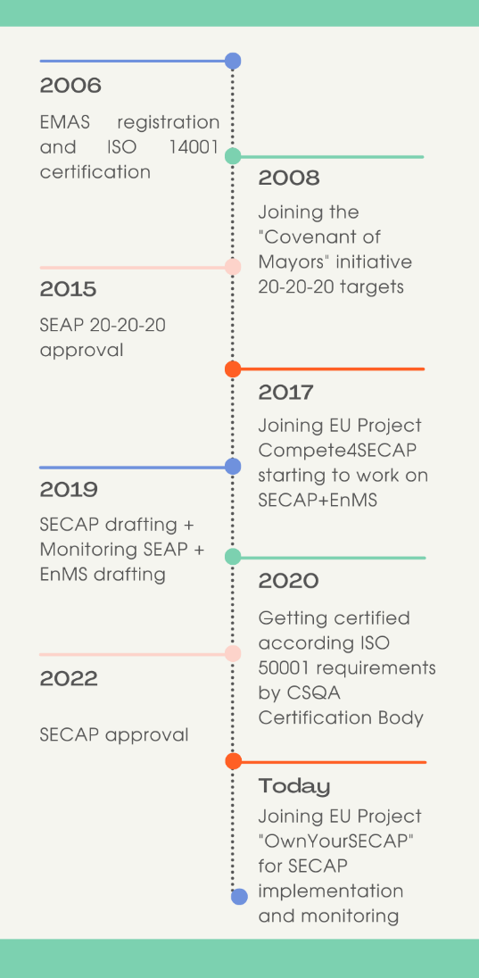
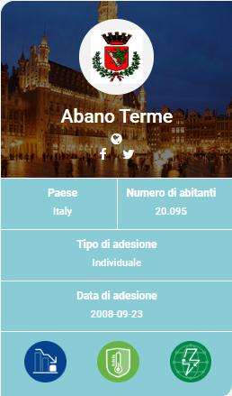

The City path towards sustainability
The Municipality has a long tradition of managing environmental aspects and sustainability policies.

Slide 4
Our environmental and energy certifications

Slide 5
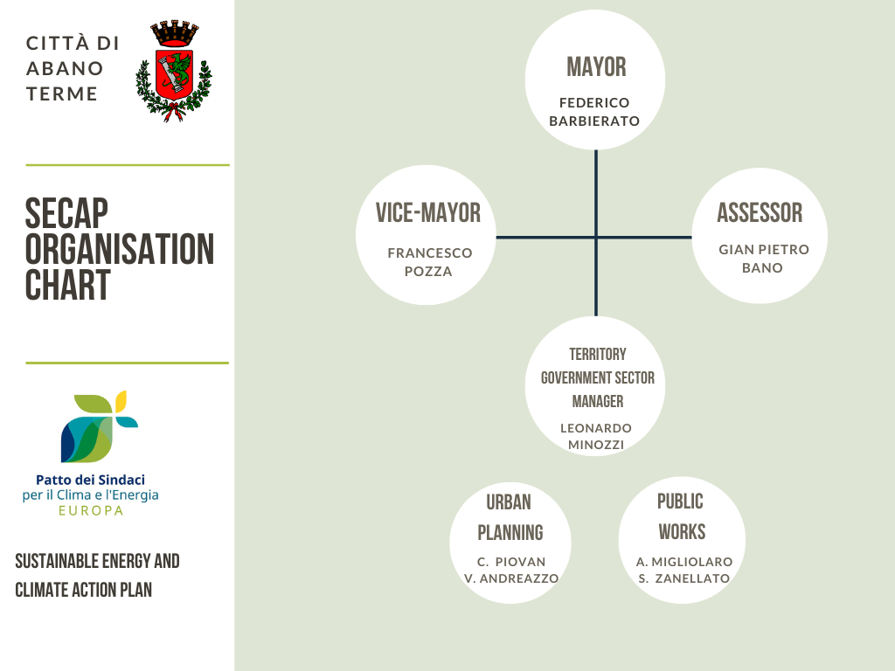
Internal organization for the implementation of the City’s Sustainability Policy

Slide 6
Planning mitigation and adaptation to climate change
In order to reach mitigation and resilience targets, the City officially adopted a set of plans, regulations, standards and contracts:
• Municipal Water Infrastructure Plan
• Municipal Green Plan – Abano Green City
• Municipal Strategic Urban Plan (P.A.T.)
• Building Regulations R.I.E.
• Civil Protection Plan
• Sustainable Mobility Metropolitan Plan
• Metropolitan Bike Plan
• EMAS + ISO 14001
• Energy Management System ISO 50001 (includes ALL LA’s assets)
• Public Lighting Plan + ESCO contract
• 14 Energy Diagnosis UNI 16247 on Municipal Buildings and facilities
• Project Financing contract on Municipal Buildings and facilities

Slide 7
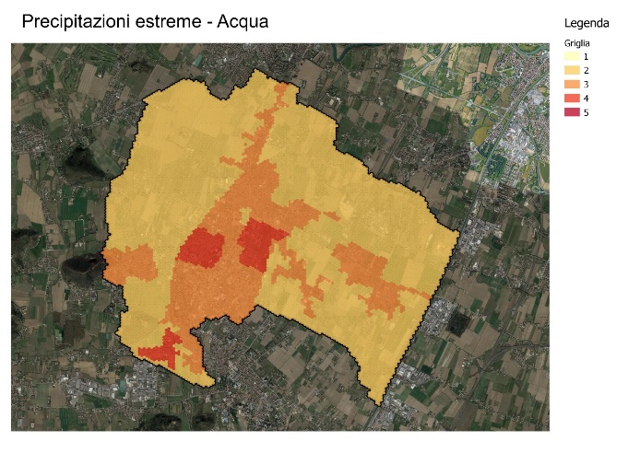
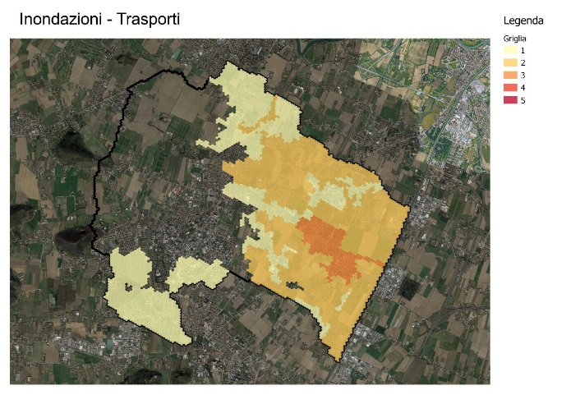
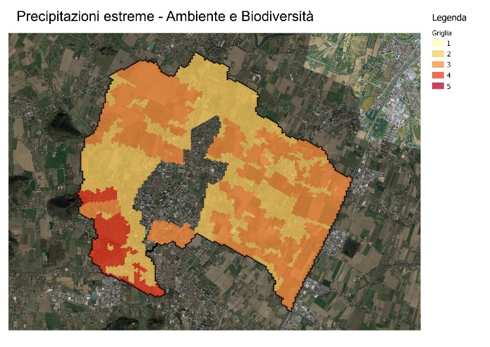
Planning mitigation and adaptation to climate change
In particular:
• Municipal Water Infrastructure Plan
Frames the hydraulic situation of the area by identifying the critical hydraulics and the related design solutions with the aim of reducing and mitigating the hydraulic risk.
Over 1,5 mln of € of investments to secure the LA’s territory to flooding events

Slide 8
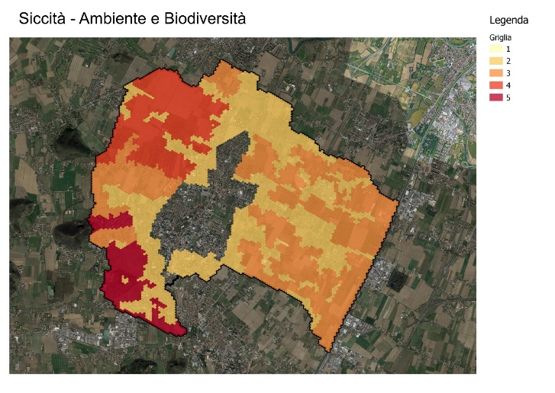
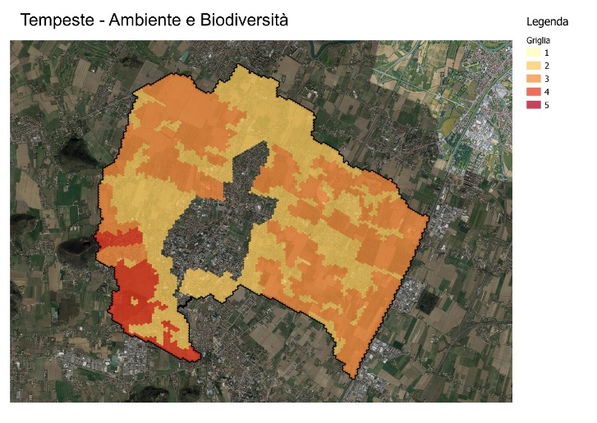
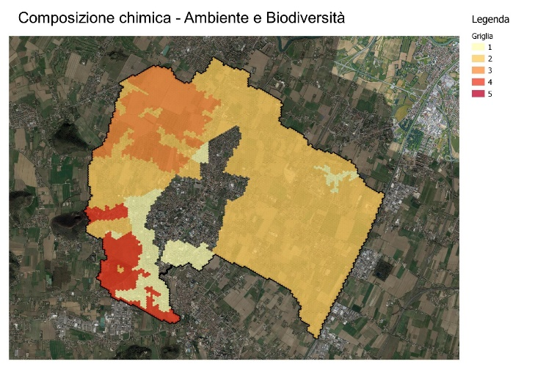
Planning mitigation and adaptation to climate change
In particular:
• Municipal Green Infrastructure Plan
represents a strategic resource for directing local development policies towards sustainability, quality, resilience, health care and widespread well-being, creation of ecological networks and protection of biodiversity
• Avenues and roads with trees in the project: 21.3 km (2,436 new trees)
• Project urban parks: 19 ha
• Project equipped green areas: 2.9 ha
• Project urban forestation: 8.4 ha
• Project sports areas: 2.1 ha
+ 42% of green areas at urban level by 2030

Slide 9
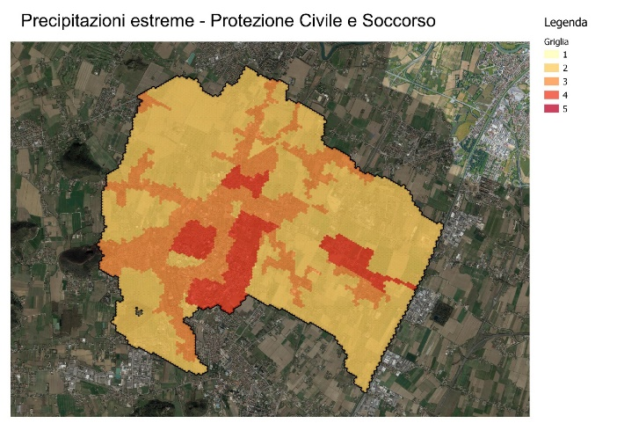
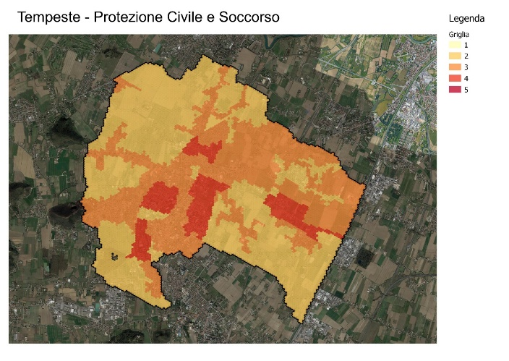
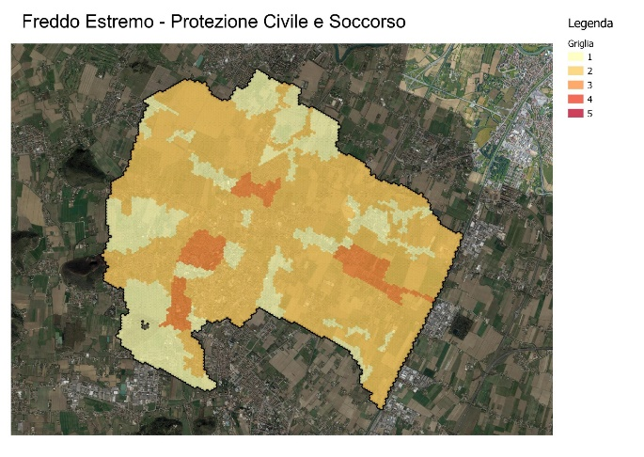
Planning mitigation and adaptation to climate change
In particular:
• Civil Protection Plan
Defines the framework of the risks which, taking into account the elements identified, may occur in the municipal area, with particular regard to those which are more likely to occur.
The main purpose of the Plan is not only the prevention of possible risks but also their identification, timely assistance to the population and precise information to be communicated to the subjects who must act in case of heavy events.

Slide 10
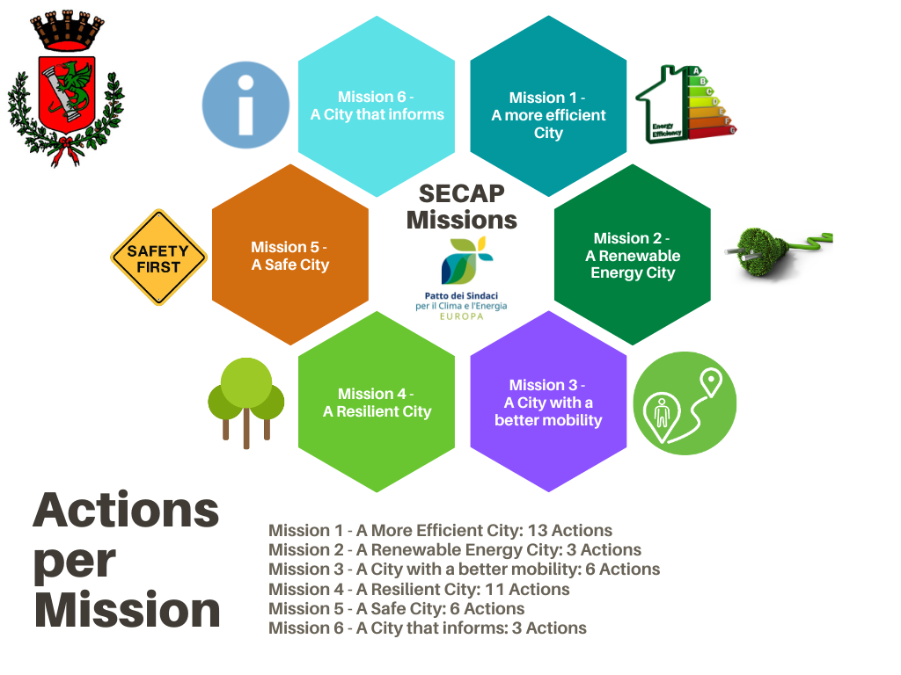
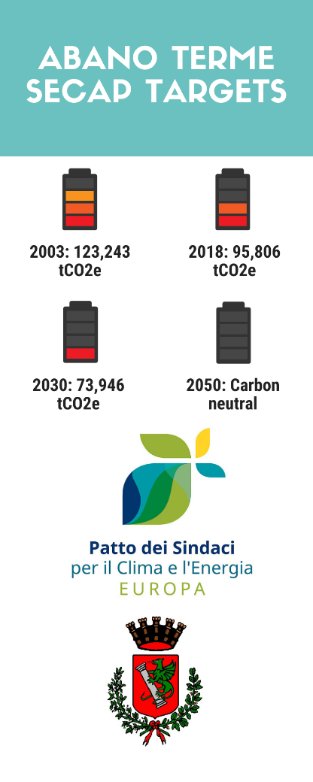
SECAP Missions and targets

Slide 11
SECAP targets and actions
Increased production of renewable energy
Reduction of energy demand in LA's assets, Residential, Tertiary
Increased resilience to climate change
Grants and funds to support projects for sustainability and resilience
Development of Renewable Energy Communities
Reduction of transport emissions
Fight against energy poverty
-22,3% Achieved in 2018
-18,94% Planned by 2030
-41,2%
SECAP target by 2030

Slide 12
SECAP Actions selected for the implementation in OYS
In accordance with the project criteria and with the priorities identified by the Municipality, Abano Terme is working on the implementation of the following SECAP actions thanks to the support of OYS Project
Top 9 Actions
PLANNING FEES RELIEF TO SUPPORT ENERGY REFURBISHMENT IN PRIVATE BUILDINGS
ENERGY EFFICIENCY OF THE POLICLINIC (REDEVELOPMENT OF THE FORMER HOTEL MAGNOLIA)
URBAN PLAN FOR CYCLING MOBILITY - INSTALLATION OF ELECTRIC RECHARGING STATION FOR BICYCLES
URBAN PLAN FOR CYCLE MOBILITY - NEW CYCLE PATH IN COLLABORATION WITH Alì SUPERMARKETS
URBAN PLAN FOR CYCLING MOBILITY - BICIBUS PROJECT FOR PRIMARY SCHOOL
URBAN PLAN FOR CYCLING MOBILITY - INVOLVEMENT OF HOTELS FOR BICYCLE RENTAL AND CYCLING AND PEDESTRIAN ROUTES
LIMITED TRAFFIC ZONES - URBAN TRAFFIC PLAN WITH EXTENSION OF AREAS 30 km/h
TRAFFIC FLUIDIFICATION AND NEW ROUNDABOUTS
PLANNING TOOLS AT THE SERVICE OF ADAPTATION TO CLIMATE CHANGE - CLASSIFICATION OF BLOCKS (P.I.)
Additional Actions identified as priorities
WATER PLAN - REVIEW AND UPDATE OF THE WATER PLAN
WATER PLAN - RESETTING AND CLEANING CONSORTIAL DRAINAGES AND PRIVATE DITCHES
MONITORING AND REDUCTION OF WATER LEAKS FROM THE WATER NETWORK
PREVENTION OF BIOLOGICAL RISK IN AGRICULTURE - COMMUNICATION ACTIVITIES ON THE USE OF PHYTOSANITARY PRODUCTS
ENVIRONMENTAL AWARENESS OF STAKEHOLDERS
INCREASE IN SEPARATE WASTE COLLECTION AND NEW ECOCENTRE

Slide 13











Contacts
Sandra Zanellato
ambiente@abanoterme.net
+39 049 8245321
STAY IN TOUCH
www.ownyourSECAP.eu
info@ownyourSECAP.eu
#OwnyourSECAP
#OwnyourSECAPItaly

