Slide 1
City Of Lorient
City of Lorient
ISO 50 001
Vienne - 26/05/2023
Notes:
I would like to present the ISO 50001 certified energy management approach of the city of Lorient.
-----
Je vous propose ici de vous présenter la démarche de management de l'énergie certifiée ISO 50001 sur la ville de Lorient.

Slide 2
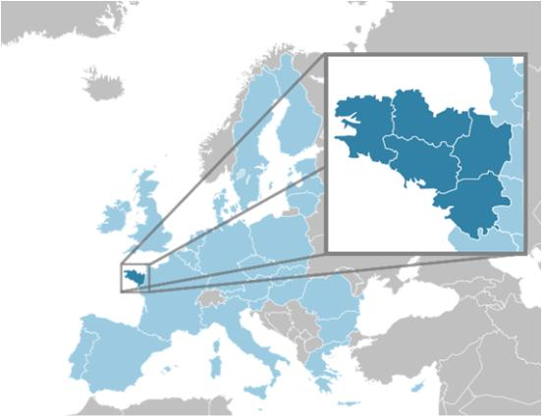
City of Lorient
West of France in the Brittany region
A port city
57 000 inhabitants (conurbation ~200 000)
An engaged city :
European energy award since 2015
Gold level since 2020
EMS since 2019 : Compete4SECAP
Certified since 2020
Surveillance audit number 2 : June 023
ISO 50 001 on all the perimeter :
233 municipal buildings (300 000 m²)
9956 street lamps
178 vehicles
Notes:
The city is committed to an Energy Management System since 2019 as part of the Compete4SECAP project.
It was certified in 2020 and will have its next surveillance audit in June 2023.
The standard is deployed on all the city's infrastructures, making energy a major issue.
-----------
La ville est engagée dans un Système de Management de l'Energie depuis 2019 dans le cadre du projet Compete4SECAP.
Elle a été certifiée en 2020 et aura son prochain audit de surveillance en juin 2023.

Slide 3
French context
PCAET - SECAP
From 2019: Obligation to set up a SECAP for inter-municipalities with more than 20,000 inhabitants
National low carbon strategy (SNBC)
France's roadmap to carbon neutrality by 2050
Tertiary decree
All buildings over 1,000 m² must reduce their energy consumption by 40% by 2030 and 60% by 2050 compared to 2010.
Resiliance planning
Series of actions to reduce energy consumption to ensure energy supply during winter.
Notes:
PCAET
A Territorial Climate Air and Energy Plan (PCAET) is a territorial energy and ecological transition project which aims to
- to reduce the territory's greenhouse gas (GHG) emissions in order to combat climate change ("mitigation" component)
- adapting the territory to the effects of climate change, in order to reduce its economic, social and health impacts, etc. ("adaptation" component)
- the improvement of air quality, in order to preserve the health of the territory's inhabitants.
SNBC
This is a French roadmap published in 2015. Its objectives are a 40% reduction in greenhouse gas emissions (from 1990 to 2030) and a fourfold reduction in national greenhouse gas emissions from 1990 to 2050 ("factor 4").
To achieve this, strategic guidelines and time targets are translated into a "national greenhouse gas emissions ceiling known as a 'carbon budget'".
Tertiary Decree
This is a decree imposing a progressive reduction in the energy consumption of the French tertiary sector.
The obligation to reduce energy consumption is imposed on landlords and tenants alike.
In order to ensure monitoring, the energy consumption of the buildings concerned must be sent to the OPERAT computer platform managed by ADEME from 2022. In the event of non-compliance with the obligation, obliged parties risk a fine of up to €7,500 and having their name added to a government website singling out bad performers.
-----------------
PCAET
Un Plan Climat Air Énergie Territorial (PCAET) est un projet territorial de transition énergétique et écologique qui a pour objectifs :
- la réduction des émissions de gaz à effet de serre (GES) du territoire, afin de lutter contre le changement climatique (volet «atténuation») ;
- l’adaptation du territoire aux effets du changement climatique, afin d’en diminuer les impacts économiques, sociaux, sanitaires, etc. (volet «adaptation») ;
- l’amélioration de la qualité de l’air, afin de préserver la santé des habitants du territoire.
SNBC
C'est une feuille de route française publiée en 2015. Elle pose pour objectifs une réduction de 40 % des émissions de gaz à effet de serre (de 1990 à 2030) et une division par quatre des émissions nationales de gaz à effet de serre de 1990 à 2050 (« facteur 4 »).
Pour cela, des orientations stratégiques et des objectifs temporels sont traduits en « plafond national des émissions de gaz à effet de serre dénommé “budget carbone” ».
Décret Tertiaire
C'est un décret impose une réduction progressive de la consommation énergétique du parc tertiaire français.
L’obligation de réduire les consommations d’énergie s’impose aux bailleurs comme à leurs locataires.
Afin d’assurer le suivi, les consommations énergétiques des bâtiments concernés doivent être envoyées sur la plateforme informatique OPERAT gérée par l’ADEME dès 2022. En cas de non-respect de l’obligation, les obligés risquent une amende pouvant aller jusqu’à 7 500€ et que leur nom soit ajouté sur un site étatique pointant du doigt les mauvais élèves.

Slide 4
Energy prices (while consumption drops by 11% or 20%)
Actual price in 2021 for building and public lighting / Estimated price in 2023 with resilience planning
+ 130 %
+ 115 %
Consumption
32 250 MWh
-20%
Notes:
As a result of the war in Ukraine, energy prices have risen sharply and there is a risk of power cuts in winter.
To face these difficulties, a resilience plan encouraging more energy sobriety has been implemented.
Two resilience scenarios are imagined by the city.
The first will lead to a 130% increase in the energy bill in 2023 and the second to a 115% increase.
This represents a considerable impact on the city's energy budget, which should be around six million euros in 2023.
-------------
Suite au contexte de la guerre en Ukraine, les prix de l'énergie ont fortement augmentés et des risques de coupures sont possibles l'hiver.
Pour faire face à ces difficultés, un plan de résilience incitant à plus de sobriété énergétique a été mis en oeuvre.
Deux scénarios de résilience sont imaginés par la ville.
Le premier entrainera en 2023 un hausse de la facture énergétique de 130% et le second de 115%.
Ce qui représente un impact considérable sur le budget énergie de la ville qui devrait alors être autour de six millions d'euros en 2023.

Slide 5
The objectives of the city of Lorient
2023
Reduce gas consumption by 17% compared to 2020 Reduce electricity consumption by 10% compared to 2020
2025
Reduce greenhouse gas emissions by 50% compared to 1990 50% of the heritage's consumption by renewable energies
2030
Reduce the consumption of buildings by 40% compared to 2010
Reduce the consumption of public lighting to 2.5 GWh
2040
Reduce the consumption of buildings by 50% compared to 2010
Reduce the consumption of public lighting to 0.75 GWh
60% of the heritage's consumption by renewable energies Reduce the consumption of public lighting to 1.25 GWh
50% reduction in fuel consumption compared to 2020
Notes:
The objectives stem from the regulatory obligations presented above.
These ambitious objectives are communicated through various media such as the poster on this slide.
-------
Les objectifs découlent notamment des obligations réglementaires présentés précédemment.
Ces objectifs ambitieux sont communiqués via différents supports comme l'affiche sur cette slide.

Slide 6
Energy uses
Annual energy consumption by use
Use | %2021/2022
Building | -9,2%
Street lighting | -24,5%
Transport | +3,9%
Total | -10,2%
Building
Street lignting
Transport
Notes:
Buildings, all energy sources combined, will account for 85% of energy consumption in 2022.
Public lighting and transport are the other two sources of energy consumption.
Between 2021 and 2022, a gain in energy savings of around 10% has been achieved.
In 2020 consumption was lower due to the covid 19 pandemic.
-------------
Les bâtiments, toutes énergies confondues, représente 85% des consommations d'énergie en 2022.
L'éclairage public et les transports sont les deux autres sources de consommations d'énergie.
Entre 2021 et 2022 un gain d'économie d'énergie de l'ordre de 10% a été réalisé.
2020 la consommation était plus faible suite à la pandémie du covid 19.

Slide 7
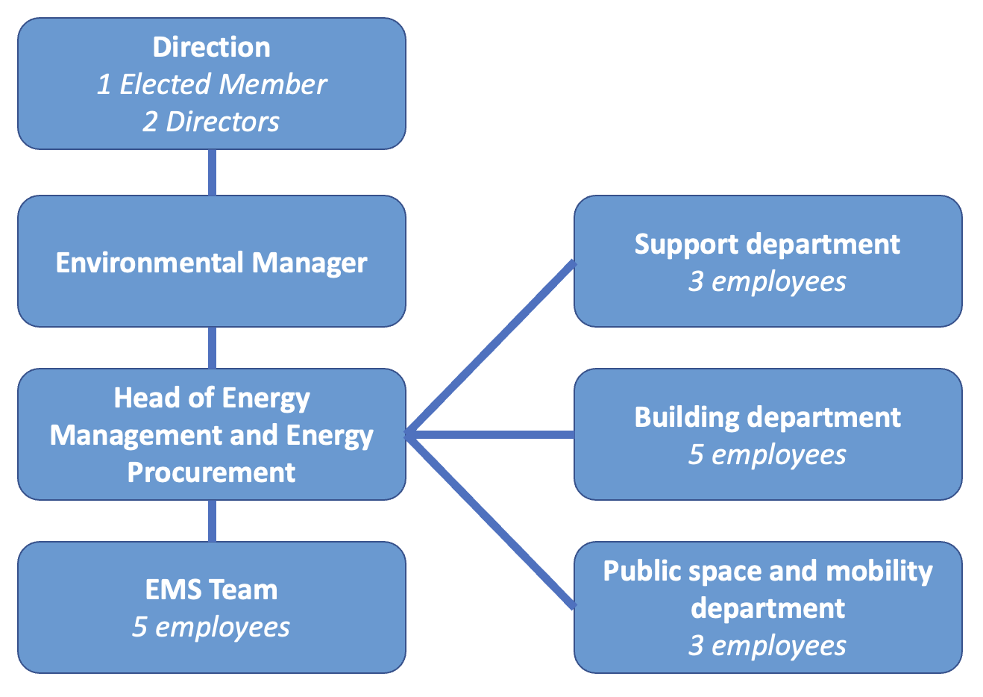
21 people involved
Notes:
21 people are involved in the EMS.
The management is composed of the Deputy Mayor for the Environment and Energy Transition as well as the Director General of Services and the Director General for Ecological Transition and Living Environment.
The link between the EMS and the management is ensured by the environment manager to whom the energy team is attached.
In a transversal manner, the support, building and public space and mobility departments are involved in running the EMS.
---------
21 personnes sont impliquées dans le EMS.
La direction est composée de l'adjoint au Maire à l'environnement et la transition énergétique ainsi que le directeur général des services et le le directeur général adjoint transition écologique et cadre de vie.
Le lien entre le EMS et la direction est assuré par le responsable environnement au quel est rattaché l'équipe énergie.
De manière transversale, le département support, bâtiment et espace public et mobilité interviennent pour animer le EMS.

Slide 8
Significant Energy Use
Significant Energy Use | Unity | IPE de référence 2010 | IPE actuel 2022 | Evolution (%)
Moustoir Technical Centre | kWh*DJU | 13 080 258 | 13 613 075 | +4%
Kerlétu Funeral Centre | kWh/number of cremation | 10 169 | 7 907 | -29%
Kerlétu Central Kitchen | kWh*DJU | 503 236 | 516 466 | +3%
Bois du Château Pool | kWh*DJU/m²Pool | 4 746 | 4 446 | -7%
Municipal Technical Centre | kWh*DJU/m² | 102 | 126 | +19%
Merville School Group | kWh*DJU/m² | 103 | 91 | -13%
Media library | kWh*DJU/m² | 141 | 117 | -21%
Notes:
7 significant energy uses were identified.
The moustoir Technical center includes :
The city hall
A stadium
An aquatic center
A theater
They correspond to 10 buildings whose total consumption (heating and electricity) represents about half of the energy expenditure of the buildings.
Since 2010 :
Strong decrease :
- Kerlétu Funeral Centre
- Media library
- Merville School Group
-Bois du Château Pool
Increase in :
- Municipal Technical Centre
Stagnation :
- Moustoir Technical Centre
Kerlétu Central Kitchen
---------------
7 usages énergétiques significatifs ont été identifiés. Ils correspondent à 7 bâtiments dont la consommation totale (chauffage et électricité) représente environ la moitié des dépenses énergétiques du patrimoine immobilier.

Slide 9
Energy Performance
 |  | 2010 | 2012 | 2018 | 2019 | 2020 | 2021 | 2022 | Advancement
Building | Consumption | 33,0 GWh | 29,5 GWh | 28,8 GWh | 28,7 GWh | 23,1 GWh | 28,9 GWh | 26,2 GWh
 | Evolution compared to 2010 | 0% | -11% | -13% | -13% | -30% | -13% | -21%
Street lighting | Consumption | - | 5,8 GWh | 4,8 GWh | 4,5 GWh | 4,3 GWh | 3,8 GWh | 2,8 GWh
 | Evolution compared to 2012 | - | 0,00% | -17,40% | -22,30% | -25,80% | -35,60% | -51,40%
Transport | Consumption | - | - | 1,72 GWh | 1,70 GWh | 1,37 GWh | 1,61 GWh | 1,68 GWh
 | Evolution compared to 2020 | - | - | - | - | 0% | +17% | +23%
Renewable energy | Production | - | - | 272,5 MWh | 434,5 MWh | 467,5 MWh | 500,5 MWh | 577,5 MWh
 | Coverage rate | - | - | 23% | 24% | 22% | 26% | 33%
Notes:
Building: Half of the target still to be reached in 8 years
Public lighting: Programming of night-time extinction and deployment of LEDs
(2022 is a full year of night-time extinction)
- Transport: Implementation of new indicators
- Total fuel consumption → transport vehicles, machinery and heavy goods vehicles
Fuel consumption specific to transport vehicles
Renewable energy experience a decrease in 2023 due to a change of electricity supplier the production share including purchase and production of green electricity.
----------------
Batiment : Il reste la moitié de l'objectif à atteindre en 8 ans
Eclairage public : Programmation d'une extinction nocturne et déploiement de led
(2022 est une année complète d'extinction nocturne)
Transport : Mise en place de nouveaux indicateurs
- La consommation carburant total → véhicules de transport, engins et poids-lourds
- La consommation carburant spécifique aux véhicules de transport
Energie renouvelable connaissent une baisse en 2023 suite à un changement de fournisseur d'électricité la part de production comprenant l'achat et la production d'électricité verte.

Slide 10
Action Plan
Annual advancement | 2020 | 2021 | 2022
Planned actions | 1 | 7 | 39
Actions completed | 1 | 7 | 21
% realisation | 100% | 100% | 54%
Actions |  | % realisation
Building | 13 | 31%
Street Lighting | 1 | 100%
EMS | 22 | 64%
Others | 2 | 100%
Total | 38
2022 :
22 actions concerning the EMS → respond to NCs
13 actions concerning buildings → Direct actions: Cross-functional work needs to be strengthened between the energy and building departments
Actions taken:
Implementation of a metering plan with information recording → Delay in ordering meters
Deployment of temperature sensors in school groups and gymnasiums
Launching of an energy audit (media library)
2023 :
Continuation of energy audits
Connection of the CTM to the Bodélio DHS
Deployment of the metering plan for the Moustoir technical centre
Notes:
When the EMS was set up, the number of actions was small but all were carried out. Last year many actions were identified but only half were implemented.
These actions concerned street lighting, building and EMS.
-----
A la mise en place du EMS le nombre d'action était faible mais toutes étaient réalisées. L'année dernière beaucoup d'actions ont été identifié mais seulement la moitié ont étaient implémentés.
Ces actions concernées aussi bien l'éclairage public, le bâtiment et l'EMS.

Slide 11
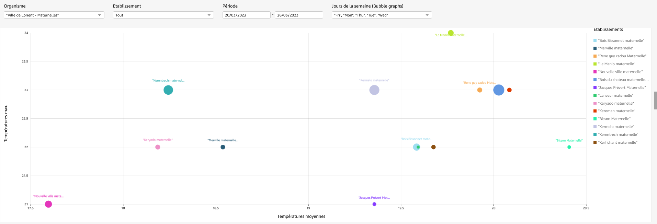
Bubble temperature graph
A building is represented by a bubble positioned according to the average temperature and the maximum temperature observed over a given period.
24 °C
Maximum temperature
21 °C
17,5 °C
Average temperature of sensors in a building
20,5 °C
Notes:
Following the covid pandemic, sensors were installed in schools, gymnasiums and the town hall to analyse the air quality.
This gives us access to the temperature of different rooms and therefore determines which buildings have high temperatures during the heating season.
On this graph a bubble represents a building.
Each bubble is positioned according to the average temperature of the probes and the maximum temperature observed.
This makes it possible to identify buildings that tend to have high temperatures and those that may have peaks.
---------
Suite à la pandémie du covid, des sondes ont été installées dans les écoles, gymnases et la mairie pour analyser la qualité de l'air.
Cela nous donne accès à la température de différentes pièces et donc de déterminé les bâtiments où la température est élevée pendant la saison de chauffe.
Sur ce graphique une bulle représente un bâtiment.
Chaque bulle est positionnée en fonction de la température moyenne des sondes et de la température maximum observée.
Cela permet d'identifier les bâtiments qui ont tendance a avoir une température élevée et ceux qui peuvent avoir des pics.

Slide 12
Heat map
Plots the change in temperature for each classroom as a function of time.
23°C
classroom
14°C
20 March 2023
Time
20 March 2023
Notes:
This graph allows you to plot for each temperature sensor its evolution as a function of time.
This ensures that when the premises are not occupied, the heating is turned off. This was the case on Wednesday 22 March as there were no classes.
It also makes it possible to identify the rooms that tend to be overheated and to raise awareness among users.
---------------
Ce graphique permet de tracer pour chaque sonde de température son évolution en fonction du temps.
Cela permet de s'assurer que lorsque les locaux ne sont pas occupés le chauffage est bien arrêté. Comme c'est le cas le mercredi 22 mars car il n'y a pas de cours.
Ça permet aussi d'identifier les salles qui ont tendance à surchauffée et d'engager une action de sensibilisation des usagers.

Slide 13
Feedback
Strengths Real political will to manage energy Cross-functional dynamics Resources: recruitment of a trainee and a technician Communication Good knowledge of consumption Actions in progress: Energy audits at the Moustoir centre | Weaknesses Estimation of energy gains Monitoring of energy gains from actions Regulatory monitoring The ISO team = support team
Opportunities New French regulations (tertiary decree) Local actors Local energy agency Presence of several higher education courses in the field of energy in Lorient Creation of a local public company that develops urban heating networks on the scale of the urban area | Threats Administrative functioning of communities EMS is too internalized in the environment department

Slide 14
Opportunities for improvement
High-level political and managerial support?
Transversality and legitimacy with operational services?
Launch of awareness-raising for staff via the agreement with ALOEN (energy agency)
Maintain the number of staff allocated to the energy department?
Maintain the SEU action funding in future budgets
How can energy savings be systematically integrated into the Multiannual investment plan?
Modification of the scope :
Monitoring of overall fuel consumption which includes small machines (park and gardens) and heavy goods vehicles (cherry pickers)
Monitoring the consumption of transport vehicles

Slide 15
Thank you
Questions ?

Slide 16
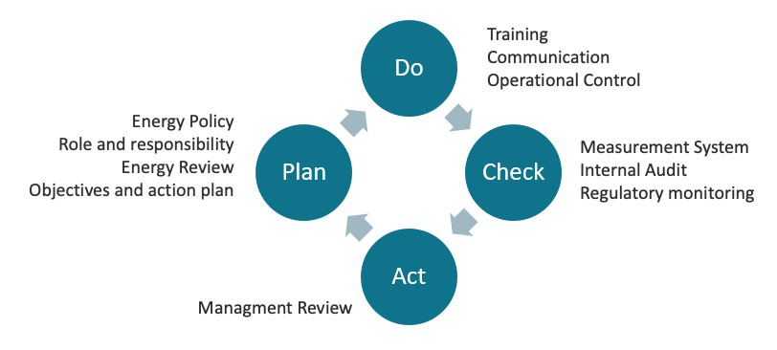
Context of the Energy Management System
An engaged city :
EMS since 2019 : Compete4SECAP
Certified since 2020
Surveillance audit number 2 : June 023
ISO 50 001 on all the perimeter :
233 buildings
9956 street lamps
178 vehicles
Notes:
The city is committed to an Energy Management System since 2019 as part of the Compete4SECAP project.
It was certified in 2020 and will have its next surveillance audit in June 2023.
The standard is deployed on all the city's infrastructures, making energy a major issue.
-----------
La ville est engagée dans un Système de Management de l'Energie depuis 2019 dans le cadre du projet Compete4SECAP.
Elle a été certifiée en 2020 et aura son prochain audit de surveillance en juin 2023.
La norme est déployée sur l'ensemble des infrastructures de la ville faisant de l'énergie un enjeux majeur.

